Slide 1
Lexia PowerUp Literacy
Information for Parents

Slide 2
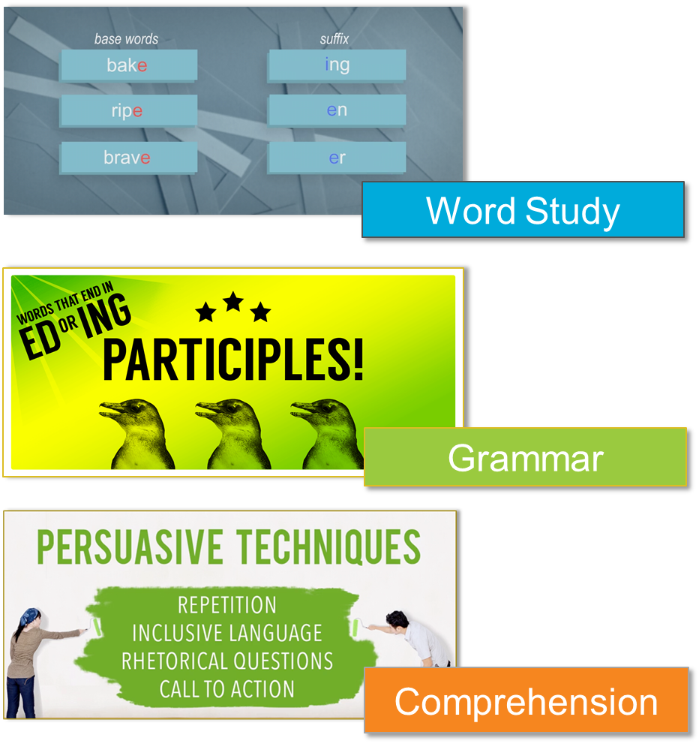
Presentation Aim
Software Overview
Integrated system
Benefits for learners
Learner experience
Home Use Best Practice
Questions and Demonstration

Slide 3
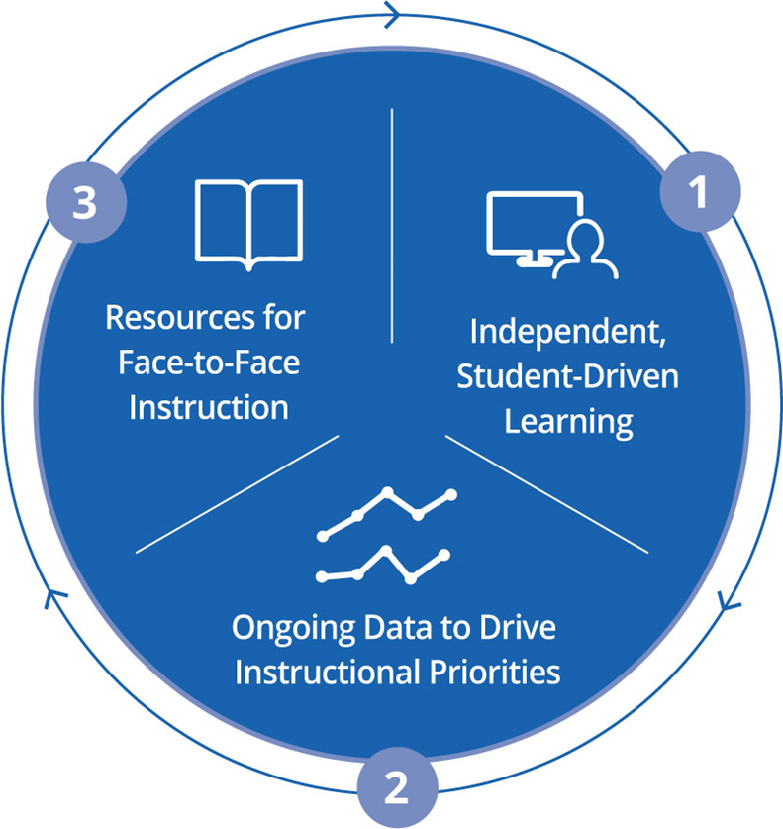
What is ?
Integrated System
Personalised, independent practise and instruction
Accurately monitors progress
Drives instructional decisions
Uses: All abilities at KS3 & catch-up KS4

Slide 4
The Simple View of Reading
DECODING
LANGUAGE COMPREHENSION
READING
COMPREHENSION
x
=
Word Study
Phonemic awareness
Letter-sound patterns
Syllable division patterns
Spelling
Fluency
Morphology
Grammar
Parts of speech
Parts of sentences
Capitalisation
Punctuation
Text structure
Comprehension
Text elements
Text structure
Author’s craft
Knowledge building
Higher-order thinking
Analysis & evaluation

Slide 5
Diversity of Need
Word Study
Grammar
Comprehension
Advanced
Auto-placement
Intermediate
Foundational

Slide 6
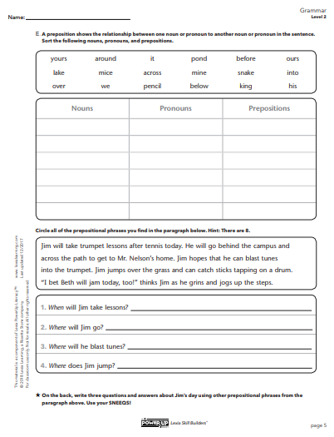
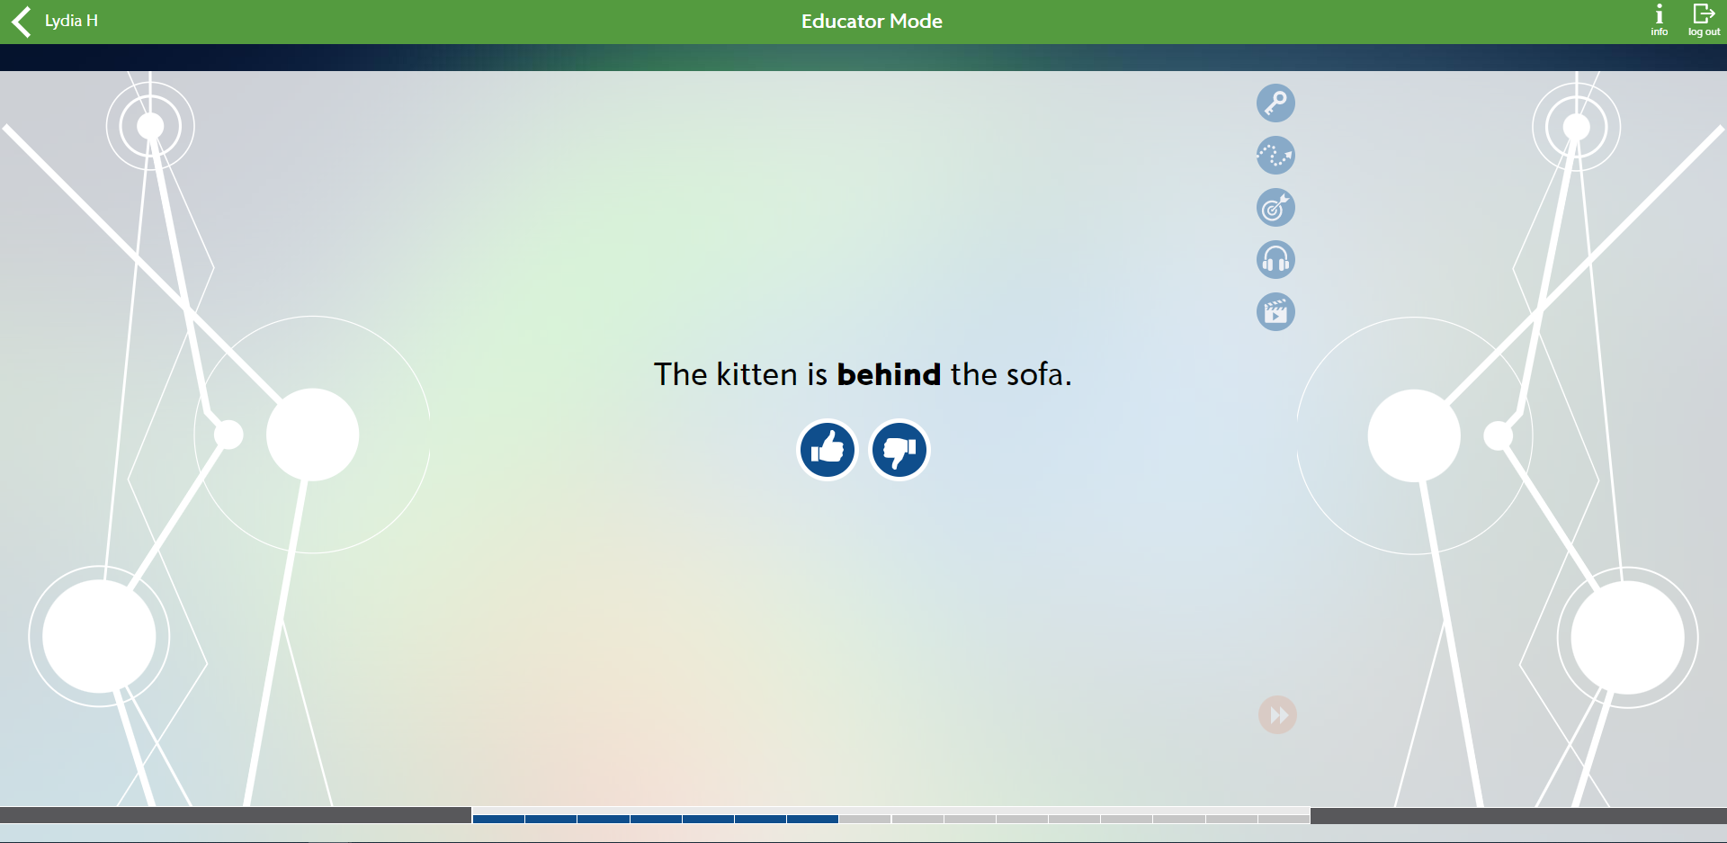
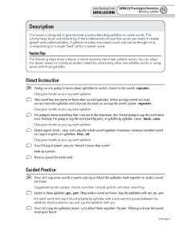
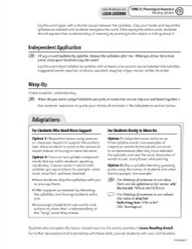
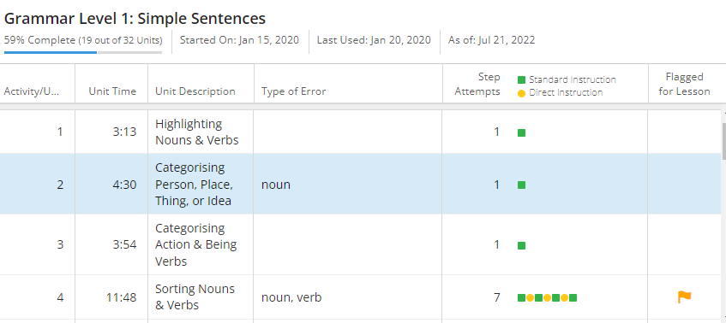
PowerUp Instructional Model
Standard Mode
Independent application
Skill Builders®
Demonstrate Mastery
Paper and pencil:
Develop automaticity
& expressive skills
Instruction Mode
Scaffolded practice
myLexia reports
Instant Feedback
Struggle repeatedly
Lexia Lessons®
Teacher-led instruction

Slide 7
Proven Results
Lexia improves reading scores
Those with greatest needs benefit the most
Closes the Reading Gap
Supports pupils with SEN and English Language Learners
Benefits of Lexia are tied to strong usage and fidelity of implementation

Slide 8
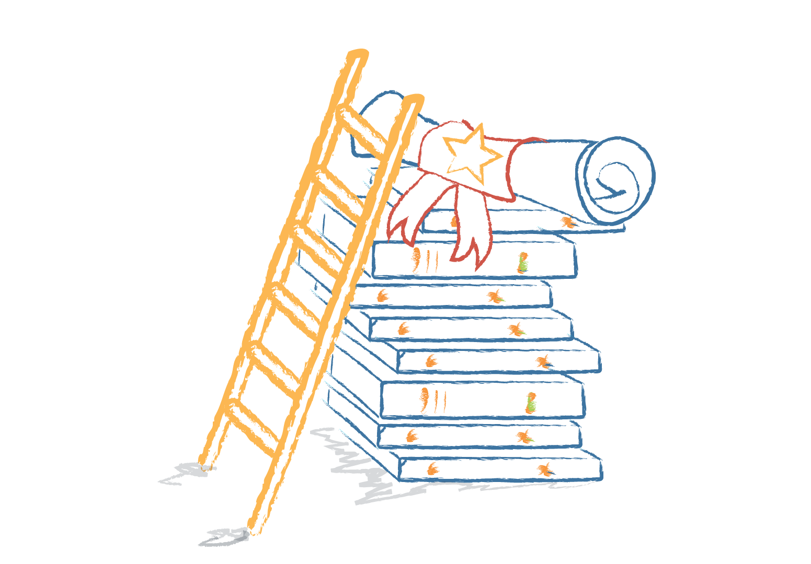
Benefits for Students
Regular independent practise (home & school)
Truly personalised
Engaging
Motivating elements (extrinsic & intrinsic)
Instant feedback
Age-appropriate
Improved curriculum access
GCSE-ready
Increased life chances (exam & career success)

Slide 9
Best Practice At Home
Tips to get the most out of Lexia:
Ensure timetabled Lexia time is built into your day.
(typically, 3-4 x 30-minute sessions / week)
Ensure your learners are working as independently as possible.
Use the Student Dashboard data to set targets and celebrate success!

Slide 10
Thank you!

